Slide 1
Unsupervised Learning: Clustering
Dr. Sourasekhar Banerjee (Ph.D.)

Slide 2
Intended Learning Outcome
Understand the meaning of clustering
Understand why we cluster data
Understand 3 main clustering algorithms
Learn how to use them in your research and work

Slide 3
Supervised vs Unsupervised
Supervised Learning requires labeled data → Used for prediction.
Unsupervised Learning works with unlabeled data → Used for finding hidden patterns.
Applications
Clustering
Anomaly detection
Voltage (V) | Capacity (Ah) | SOH (%)
3.7 | 2.0 | H
4.0 | 2.5 | H
3.6 | 1.8 | M
4.1 | 2.7 | L
3.9 | 2.2 | L
Voltage (V) | Capacity (Ah) | CLusters
3.7 | 2.0 | C1
4.0 | 2.5 | C2
3.6 | 1.8 | C1
4.1 | 2.7 | C3
3.9 | 2.2 | C3

Slide 4
Purpose of Clustering
Identify patterns and structures in unlabeled data.
Group similar data points together based on shared characteristics.
Detect anomalies and outliers (e.g., faulty battery cells)
Reduce data dimensionality for better visualization and understanding
Enhance decision-making by segmenting data into meaningful groups.

Slide 5
Clustering
Clustering is a machine learning technique used to group similar data points together.
It helps in identifying patterns and structures in large datasets without labels.
Groups are formed based on similar characteristics or predefined criteria.

Slide 6
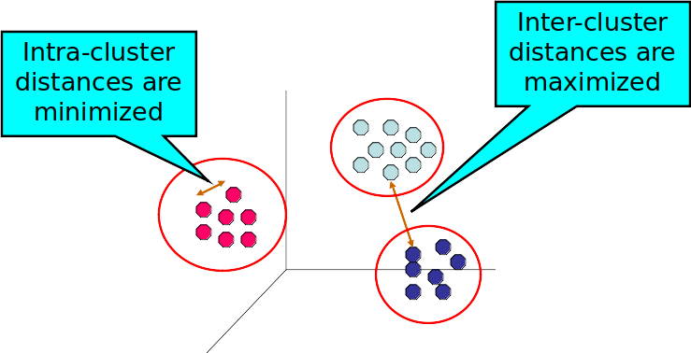
Clustering

Slide 7
Clustering Approaches
Prototype-based clustering
Density based clustering
Hierarchical clustering

Slide 8
K-means Clustering
Step 1: Select the number of clusters (K) to group the data.
Step 2: Initialize K centroids randomly from the dataset.
Step 3: Assign each data point to the nearest centroid based on distance measures (e.g., Euclidean distance).
Step 4: Compute new centroids as the mean of all points assigned to a cluster.
Step 5: Repeat steps 3 and 4 until centroids no longer change or reach a stopping condition.
Step 6: Final clusters are formed, and the algorithm terminates.

Slide 9
K-Means Example
Iteration 1
Feature 1 | Feature 2 | Centroid 0 (x,y) | Centroid 1 (x,y) | Distance to Centroid 0 (Iter 1) | Distance to Centroid 1 (Iter 1) | Assigned Cluster (Iter 1)
1 | 2 | (1, 2) | (2, 3) | 0 | 1.41 | 0
2 | 3 | (1, 2) | (2, 3) | 1.41 | 0 | 1
3 | 3 | (1, 2) | (2, 3) | 2.24 | 1 | 1
6 | 8 | (1, 2) | (2, 3) | 7.81 | 6.4 | 1
7 | 9 | (1, 2) | (2, 3) | 9.22 | 7.81 | 1
8 | 8 | (1, 2) | (2, 3) | 9.22 | 7.81 | 1
Iteration 2
Feature 1 | Feature 2 | Centroid 0 (x,y) | Centroid 1 (x,y) | Distance to Centroid 0 (Iter 1) | Distance to Centroid 1 (Iter 1) | Assigned Cluster (Iter 1)
1 | 2 | (1.0, 2.0) | (5.2, 6.2) | 0 | 5.94 | 0
2 | 3 | (1.0, 2.0) | (5.2, 6.2) | 1.41 | 4.53 | 0
3 | 3 | (1.0, 2.0) | (5.2, 6.2) | 2.24 | 3.88 | 0
6 | 8 | (1.0, 2.0) | (5.2, 6.2) | 7.81 | 1.97 | 1
7 | 9 | (1.0, 2.0) | (5.2, 6.2) | 9.22 | 3.33 | 1
8 | 8 | (1.0, 2.0) | (5.2, 6.2) | 9.22 | 3.33 | 1

Slide 10
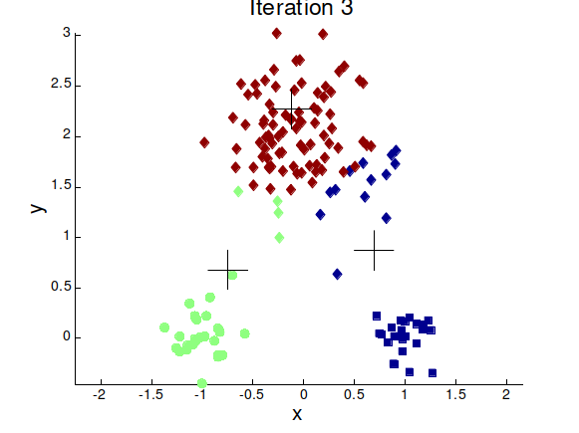
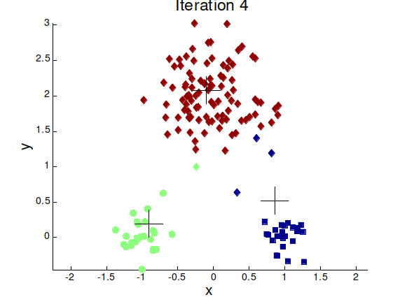
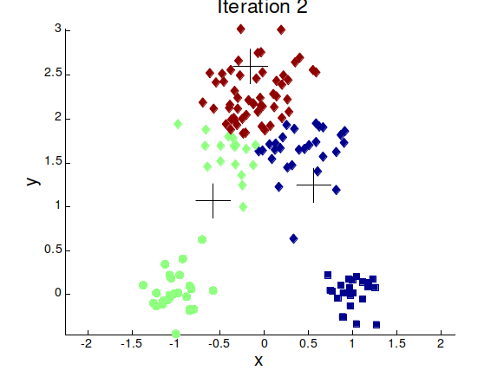
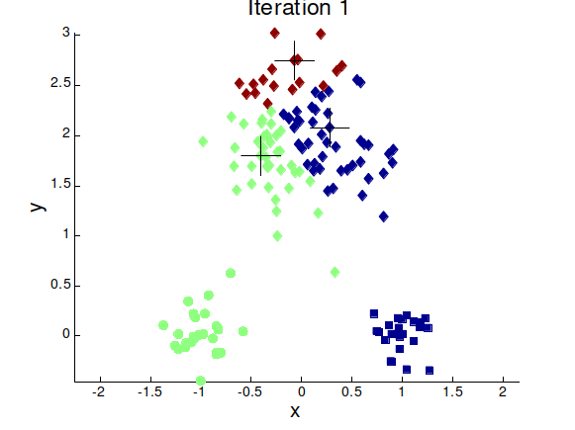


K-Means Example

Slide 11
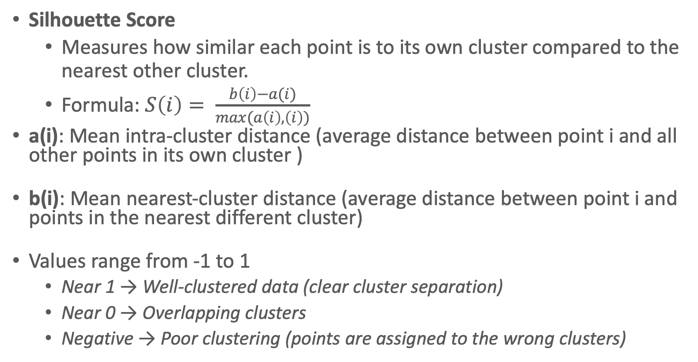
Cluster Quality Measurement
Silhouette Score
Measures how similar each point is to its own cluster compared to the nearest other cluster.
Formula: $S\left(i\right)= \frac{b\left(i\right)−a(i)}{max(a\left(i\right),\left(i\right))}$
a(i): Mean intra-cluster distance (average distance between point i and all other points in its own cluster )
b(i): Mean nearest-cluster distance (average distance between point i and points in the nearest different cluster)
Values range from -1 to 1
Near 1 → Well-clustered data (clear cluster separation)
Near 0 → Overlapping clusters
Negative → Poor clustering (points are assigned to the wrong clusters)

Slide 12
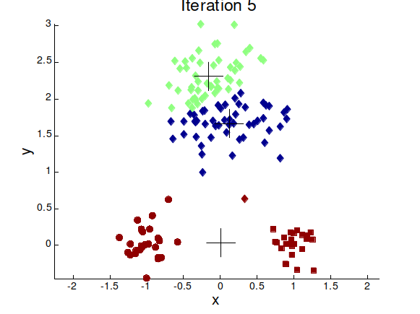
Importance of the Choice of Initial Centroid
Example with 2 different Initial centroid can generate two different clusters

Slide 13
Drawbacks of K-Means Algorithm
Convergence Speed: Poorly chosen centroids can lead to slow convergence or unnecessary iterations.
Local Minima: K-Means is an iterative optimization algorithm that may get stuck in local minima, leading to suboptimal clustering.
Cluster Quality: If the centroids are not well-initialized, clusters may be unbalanced or incorrectly formed, reducing clustering effectiveness.
Reproducibility: Random initialization can lead to different results for different runs, making clustering inconsistent.
Sensitivity to Outliers: Outliers can significantly distort the centroid positions, reducing clustering accuracy.
Predefined Number of Clusters: The number of clusters (K) must be specified in advance, which may not align with the actual data distribution.
Shape and Size Assumptions: K-Means performs best with round and evenly sized clusters, making it unsuitable for irregularly shaped or unevenly distributed clusters.

Slide 14
K-Means++
Address the issue of random centroid initialization.
Algorithm
Choose the First Centroid: Select the first centroid randomly from the data points.
Select Subsequent Centroids:
For each remaining centroid, calculate the squared distance of each data point to the nearest centroid.
Assign a probability to each point based on its distance, with farther points having a higher chance of being selected.
Select the next centroid based on this probability distribution.
Repeat Until All K Centroids Are Chosen: Continue the process until all K centroids are initialized.
Proceed with Standard K-Means: After initialization, the algorithm continues with the regular K-Means steps.

Slide 15
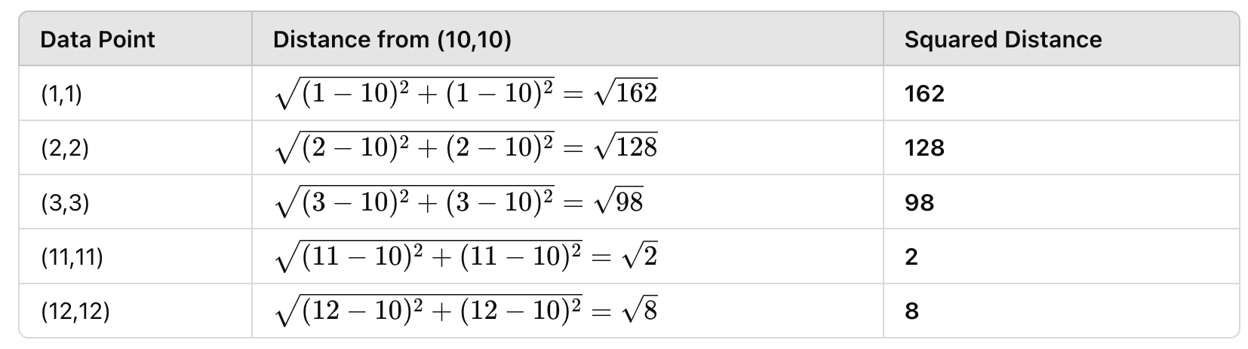
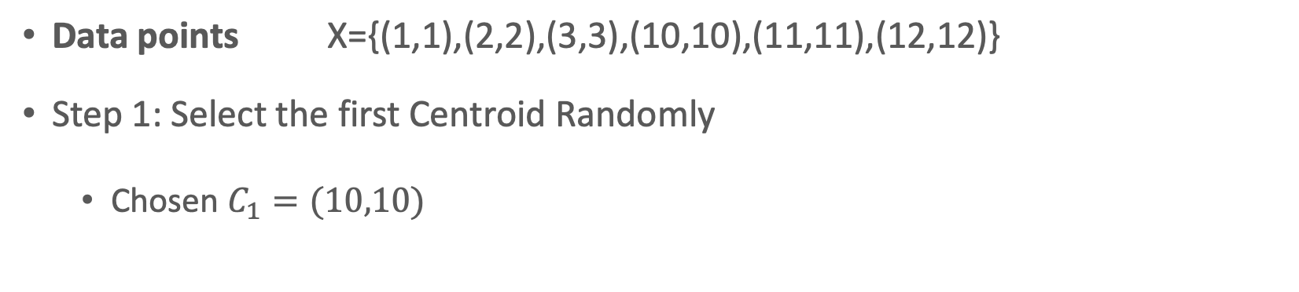
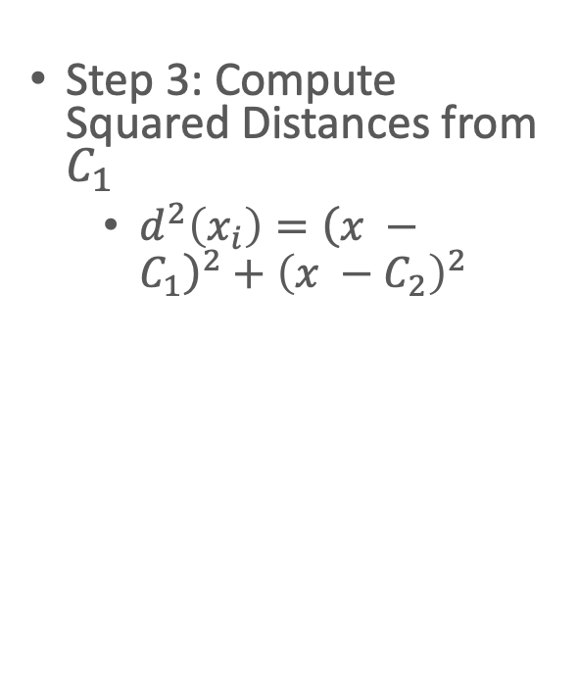
Example
Data points X={(1,1),(2,2),(3,3),(10,10),(11,11),(12,12)}
Step 1: Select the first Centroid Randomly
Chosen $C_{1}=(10,10)$
Step 3: Compute Squared Distances from $C_{1}$
$d^{2}\left(x_{i}\right)={\left(x −C_{1}\right)}^{2}+{\left(x −C_{2}\right)}^{2}$

Slide 16
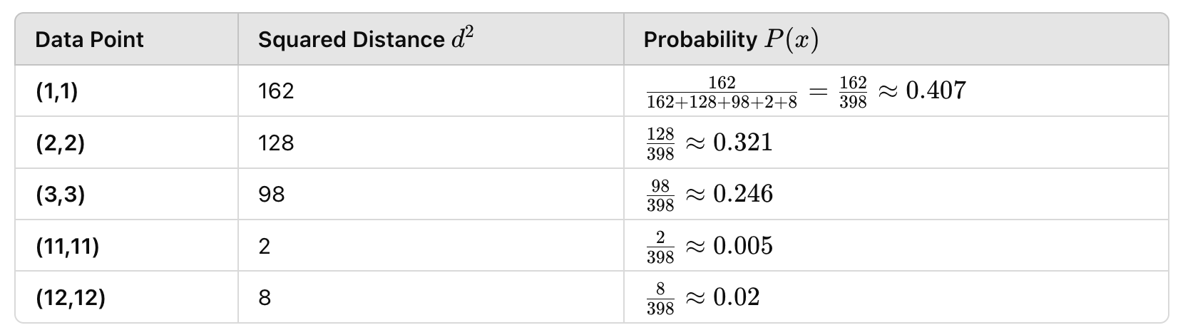
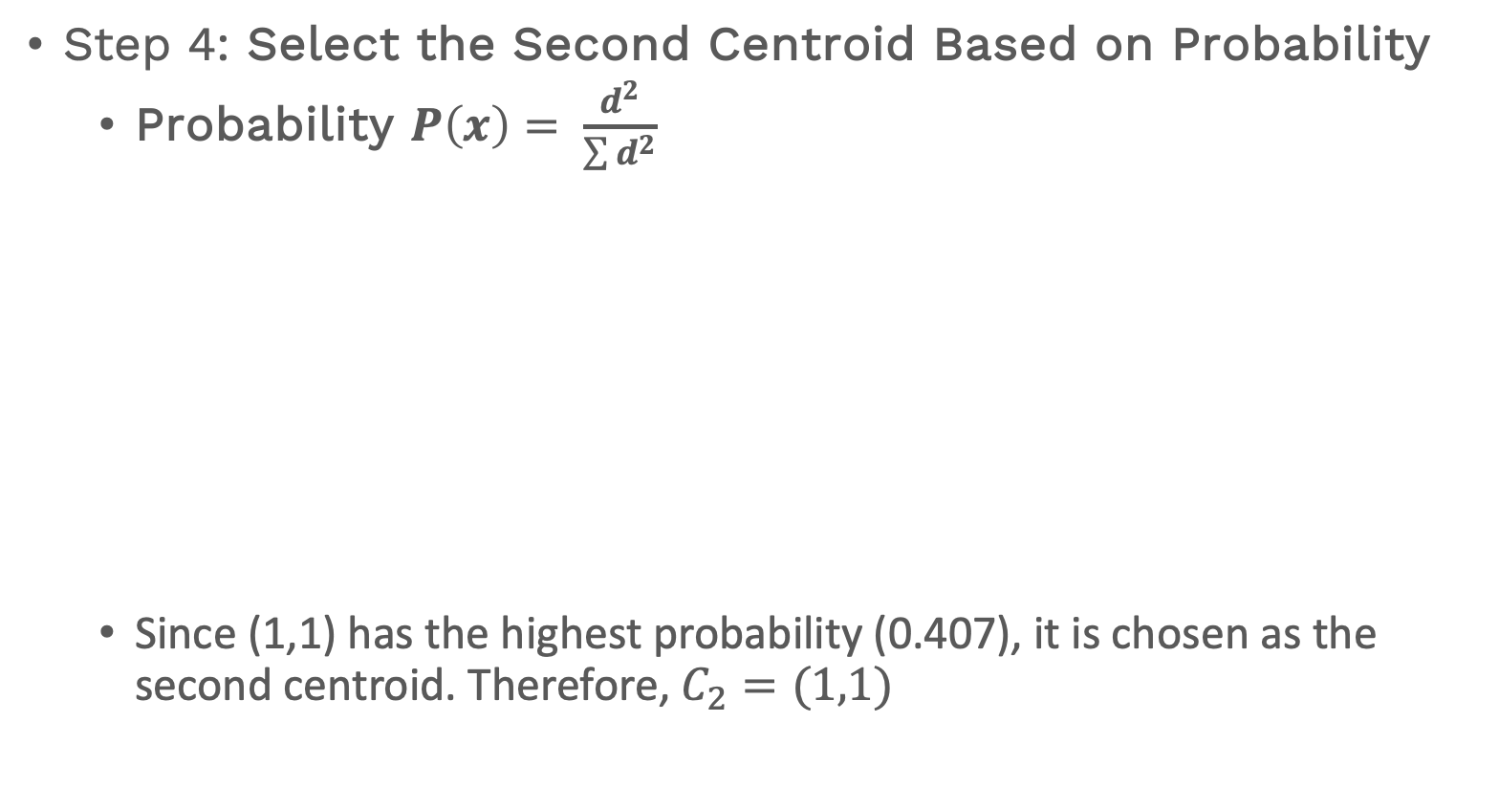
Example
Step 4: Select the Second Centroid Based on Probability
Probability $P\left(x\right)= \frac{d^{2}}{\sum{d^{2}}}$
Since (1,1) has the highest probability (0.407), it is chosen as the second centroid. Therefore, $C_{2}=(1,1)$

Slide 17
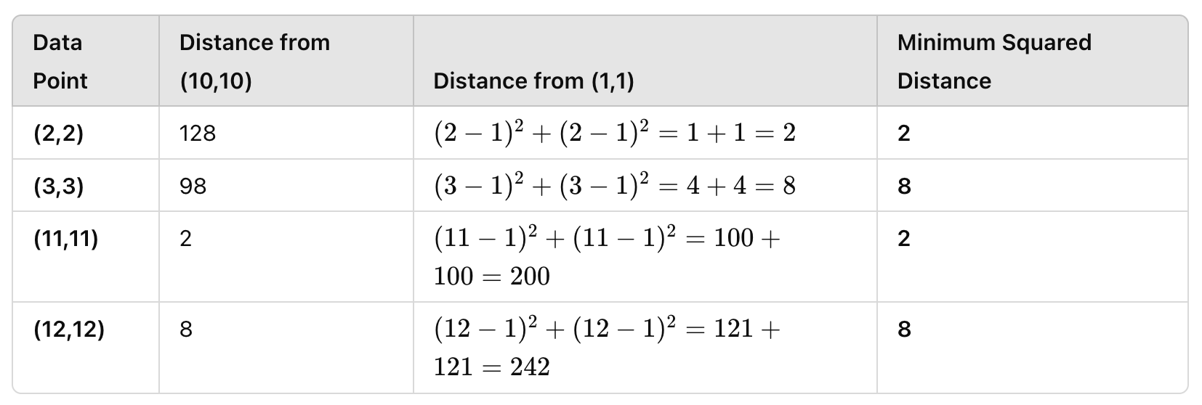
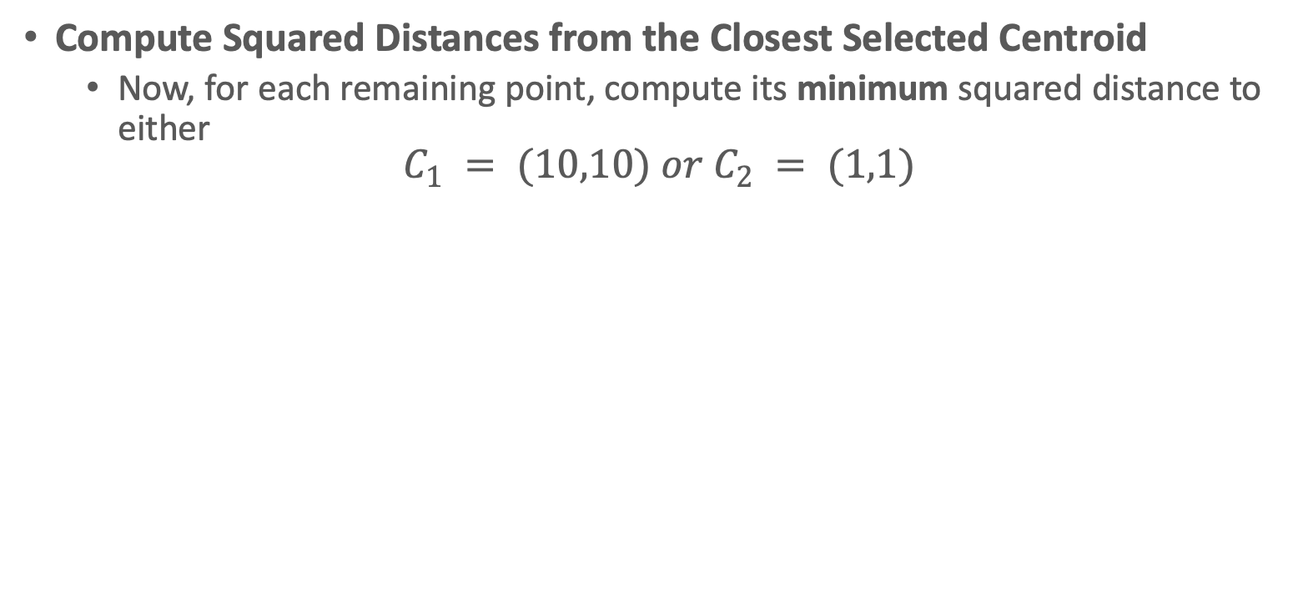
Example
Compute Squared Distances from the Closest Selected Centroid
$\text{Now}\text{, }\text{for} \text{each} \text{remaining} \text{point}\text{, }\text{compute} \text{its} \text{minimum} \text{squared} \text{distance} \text{to} \text{either}$
$$C_{1} = (10,10) or C_{2} = (1,1)$$

Slide 18
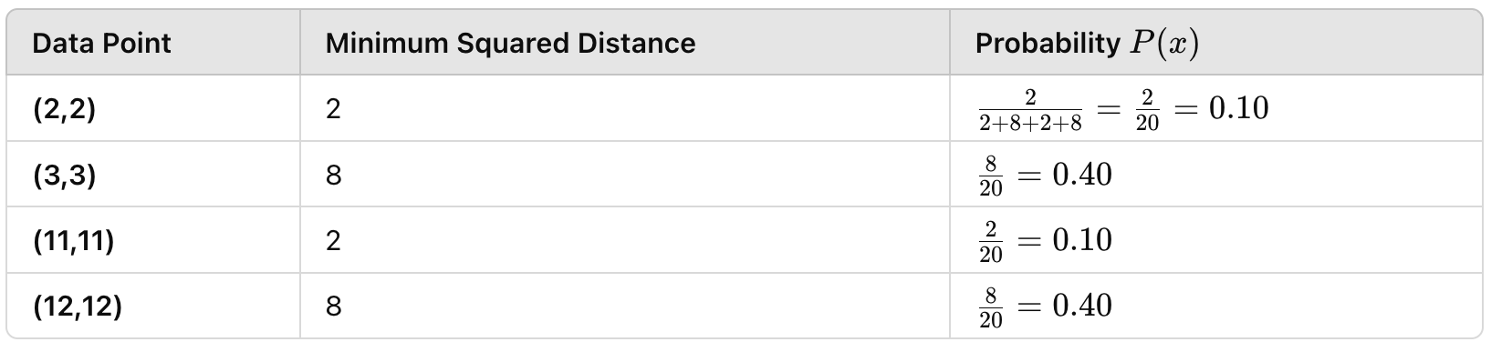
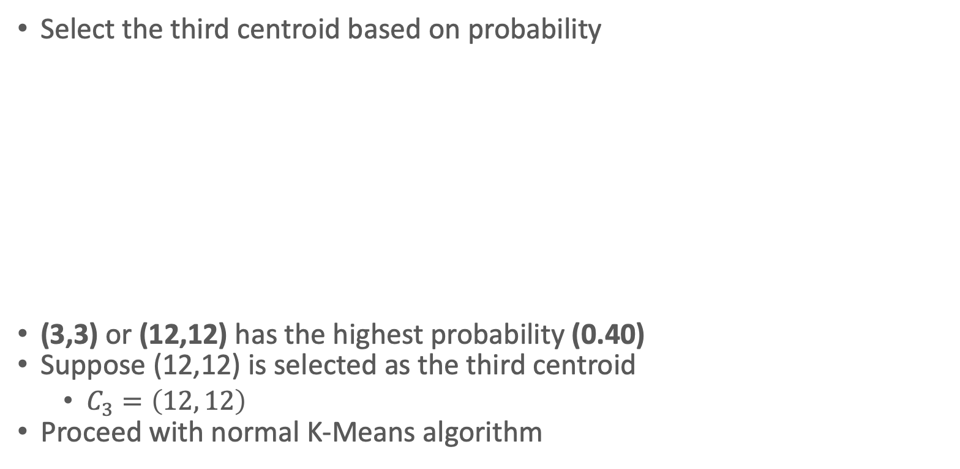
Example
Select the third centroid based on probability
(3,3) or (12,12) has the highest probability (0.40)
Suppose (12,12) is selected as the third centroid
$C_{3}=\left(12, 12\right)$
Proceed with normal K-Means algorithm

Slide 19
K-Means vs K-Means++
Enhanced spread of centroids: By selecting centroids based on distance, K-Means++ helps ensure that they are placed more effectively, making it less likely that clusters will overlap or be poorly defined.
Better Convergence: Since the initialization process in K-Means++ results in centroids being placed farther apart from each other and away from dense data areas, the algorithm tends to converge more quickly to a reasonable solution.
Robustness: The improved initialization also makes K-Means++ more robust to datasets with varying densities, shapes, and sizes of clusters

Slide 20
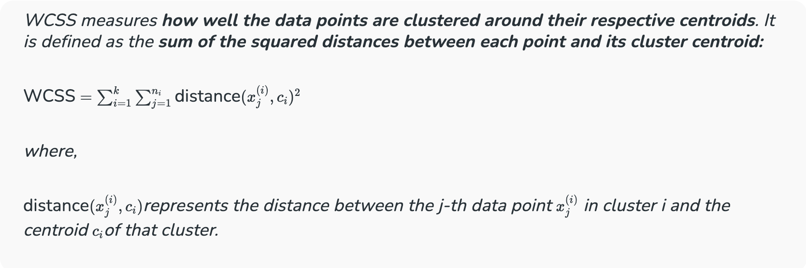
How to Determine K?
The Elbow Method helps us find this optimal k value.
We iterate over a range of k values, typically from 1 to n (where n is a hyper-parameter you choose).
For each k, we calculate the Within-Cluster Sum of Squares (WCSS).

Slide 21
The Elbow Point: Optimal k Value
We calculate a distance measure called WCSS (Within-Cluster Sum of Squares). This tells us how spread out the data points are within each cluster.
We try different k values (number of clusters). For each k, we run KMeans and calculate the WCSS.
We plot a graph with k on the X-axis and WCSS on the Y-axis.

Slide 22
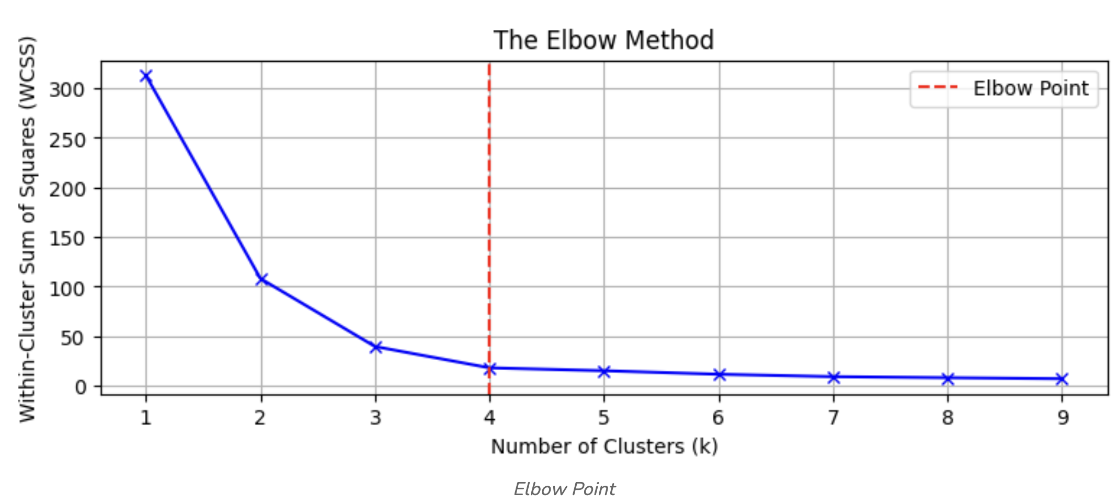
The Elbow Point: Optimal k Value
Identifying the Elbow Point: As we increase k, the WCSS typically decreases because we’re creating more clusters, which tend to capture more data variations. However, there comes a point where adding more clusters results in only a marginal decrease in WCSS. This is where we observe an “elbow” shape in the graph.
Before the elbow: Increasing k significantly reduces WCSS, indicating that new clusters effectively capture more of the data’s variability.
After the elbow: Adding more clusters results in a minimal reduction in WCSS, suggesting that these extra clusters may not be necessary and could lead to overfitting.

Slide 23
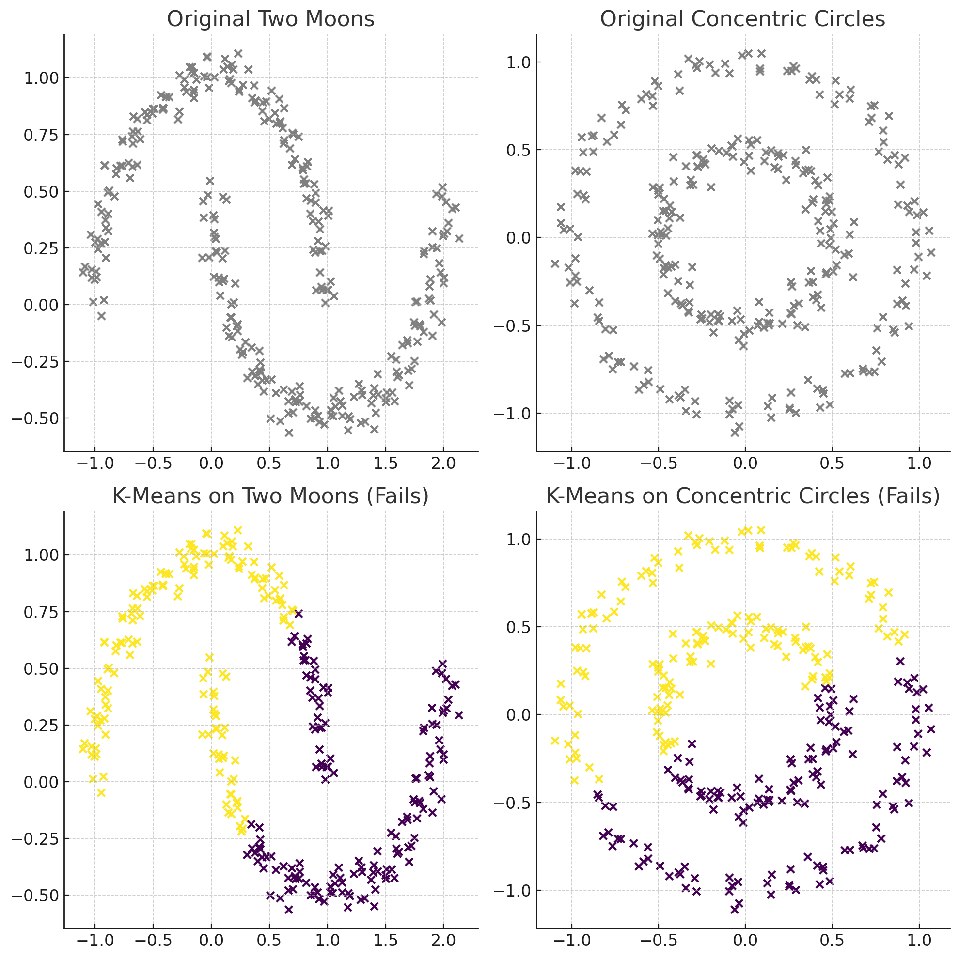
Limitations of K-Means: Handling non-Globular Shapes
K-Means relies on Euclidean distance to measure similarity, which causes problems when:
Clusters have irregular shapes (e.g., concentric circles, spirals)
Clusters are connected by curved or non-linear boundaries
Clusters have varying densities.

Slide 24
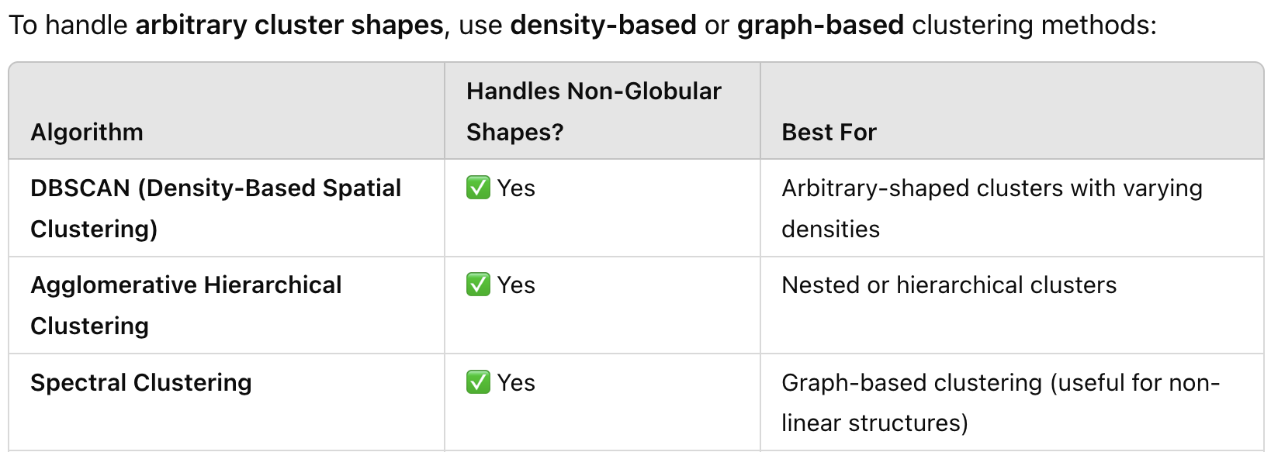
Alternatives to K-Means for Non-Globular Clusters

Slide 25
DBSCAN (Density-Based Spatial Clustering of Applications with Noise)
DBSCAN is a density-based algorithm
Density = number of points within a specified radius (Eps)
A point is a core point if it has at least a specified number of points (MinPts) within Eps
These are points that are at the interior of a cluster
Counts the point itself
A border point is not a core point but is close to a core point
A noise point is any point that is not a core point or a border point

Slide 26
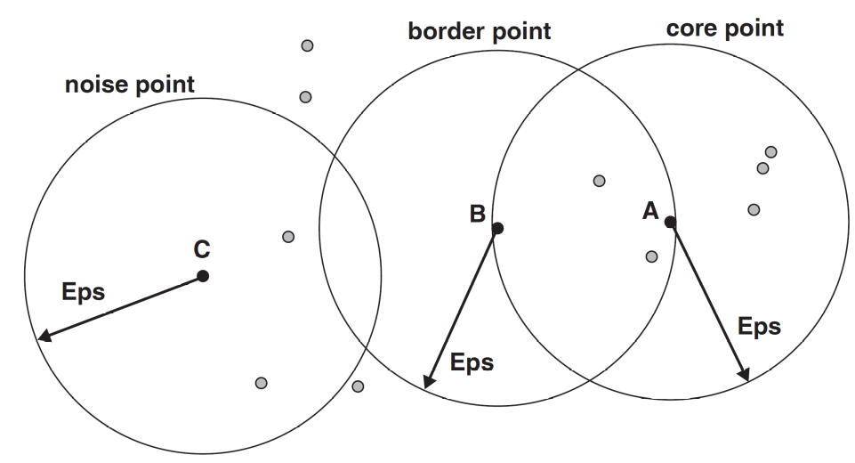
DBSCAN: Core, Border and Noise
MinPts = 7

Slide 27
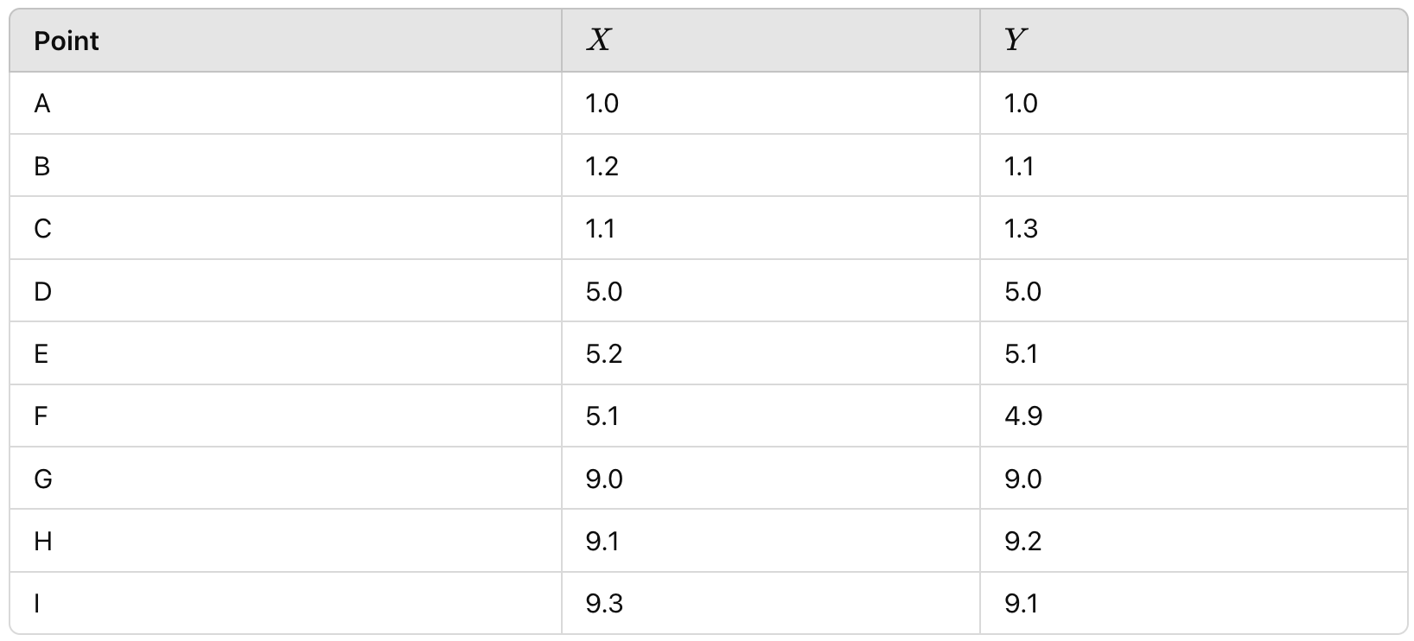
Example
Given 9 Datapoints in a 2D space

Slide 28
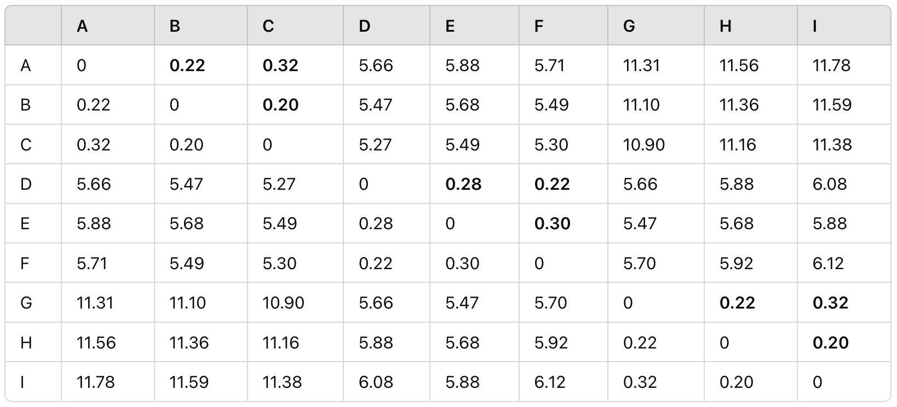
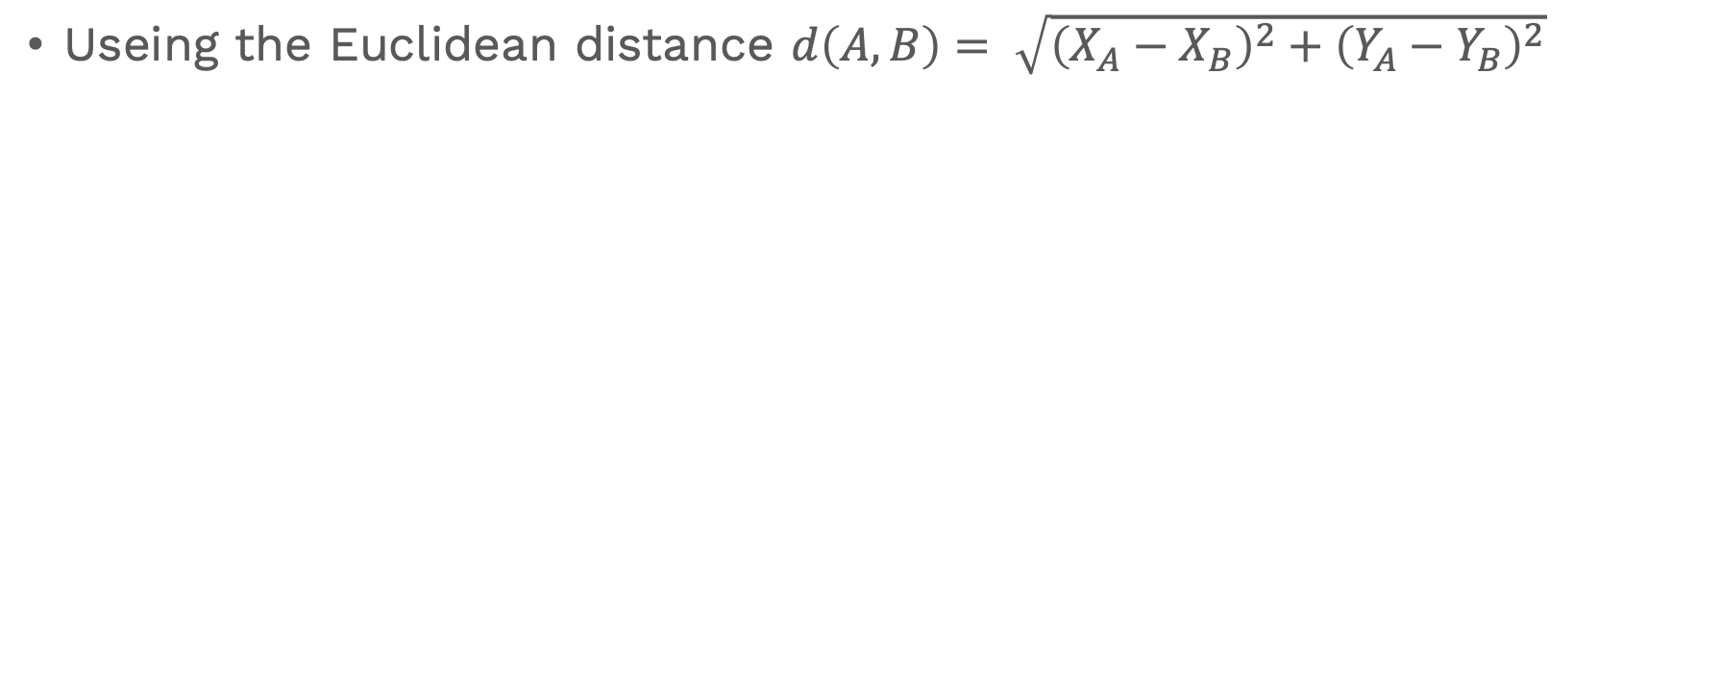
Compute Pair-wise Distance
Useing the Euclidean distance $d\left(A,B\right)= \sqrt{{\left(X_{A}−X_{B}\right)}^{2}+{\left(Y_{A}−Y_{B}\right)}^{2}}$

Slide 29
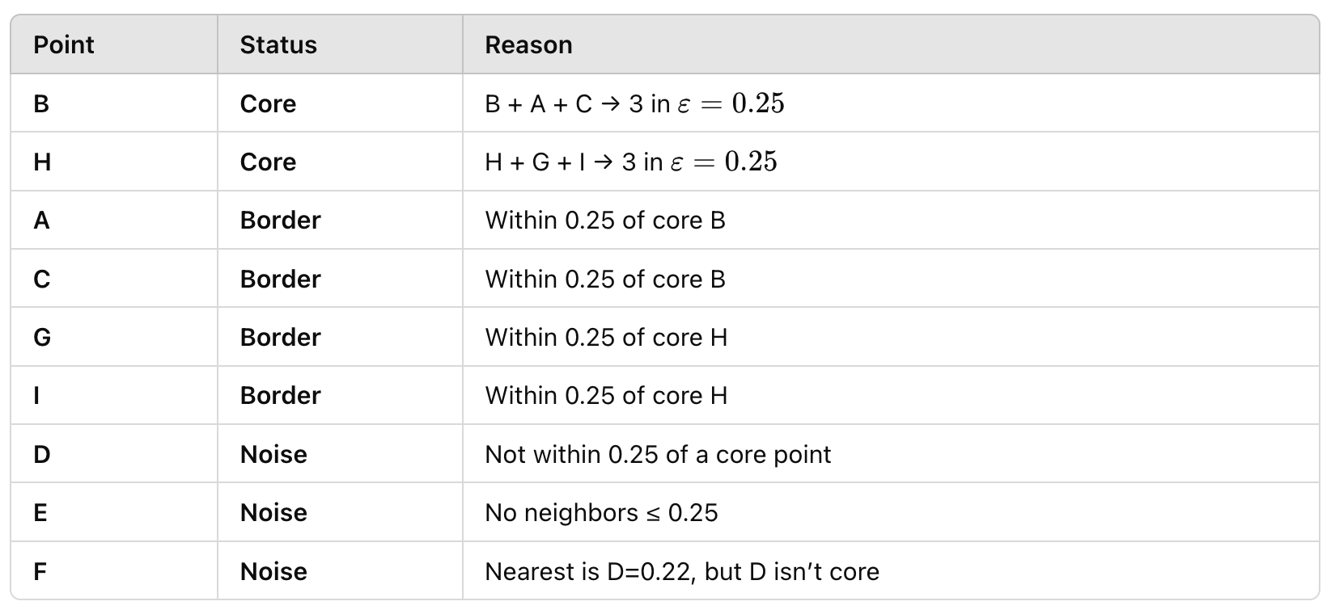
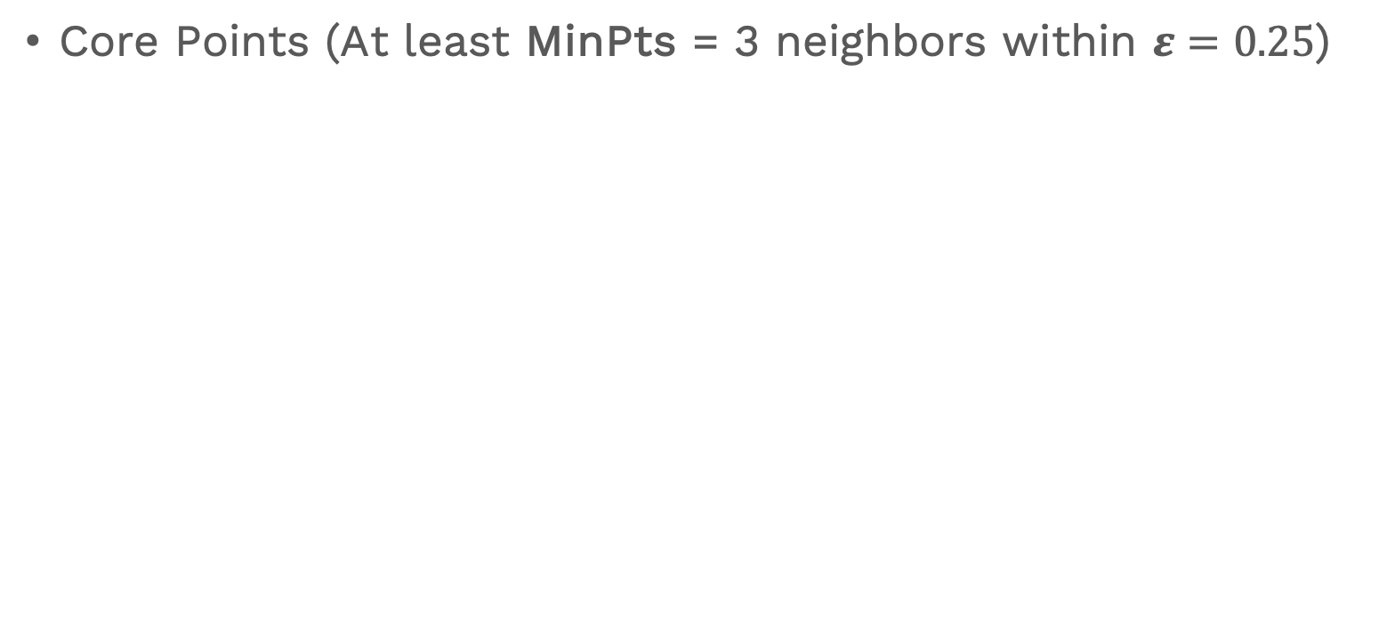
Identify Core, Border, and Noise Points
Core Points (At least MinPts = 3 neighbors within $ε=0.25$)

Slide 30
Cluster Formation
Cluster 1 (centered around B):
B (core),
A (border),
C (border)
Cluster 2 (centered around H):
H (core),
G (border),
I (border)}
Noise: {D, E, F}

Slide 31
DBSCAN: Determining EPS and MinPts
MinPts
If D is the dimension of dataset, D+1 ≤ MinPts ≤ 2D
If data is noisy choose values close to 2D
Eps
Smaller EPS → Many points are considered noise.
Larger EPS → Different clusters may merge incorrectly
As soon as you choose MinPts’ value, then you can estimate a good value for Eps using Elbow method.

Slide 32
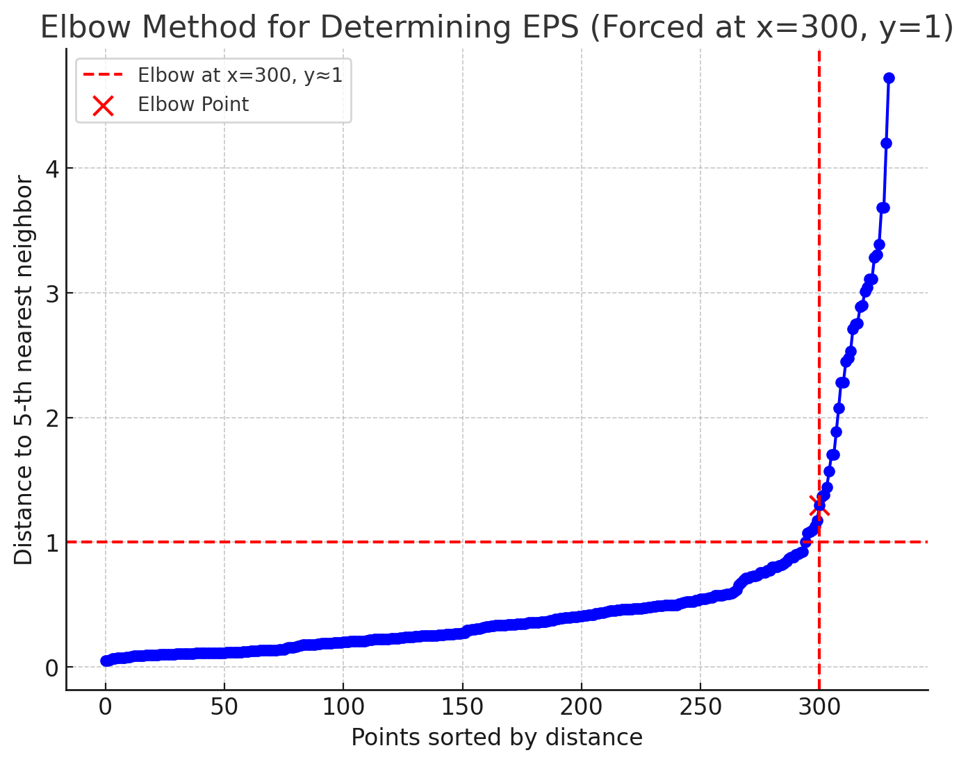
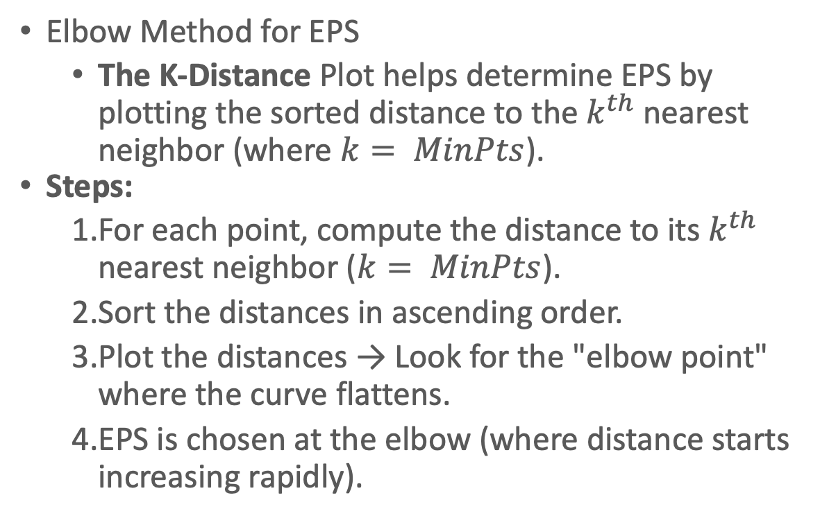
DBSCAN: Determining EPS and MinPts
Elbow Method for EPS
The K-Distance Plot helps determine EPS by plotting the sorted distance to the $k^{th}$nearest neighbor (where $k= MinPts$).
Steps:
For each point, compute the distance to its $k^{th}$ nearest neighbor ($k= MinPts$).
Sort the distances in ascending order.
Plot the distances → Look for the "elbow point" where the curve flattens.
EPS is chosen at the elbow (where distance starts increasing rapidly).

Slide 33
Hands-on

